Slide 1
SESIoN SocioEconomic Status Impact on New York State Academic Performance Dave Dyer, Nick Orangio, Ben Spivey, Kshitij Srivastava, Vuong Tran

Slide 2

Project analysis slide 10
Introduction
Socioeconomic status (SES) and its impact on academic performance is well studied and documented – lower SES is often associated with lower academic performance and vice versa^{1,2,5,6,7}
Research on SES and academic performance is heavily academic and utilizes classical statistical techniques^{3,4} – by applying modernized machine learning techniques and interactive data visualization, we will improve the insights into the relationships between SES and academic performance
We intend to improve on and add to previous research on this topic through the thoughtful application of machine learning and data visualization
We will focus on the state of New York, however we suspect our findings will be applicable and reproducible for other states in the United States

Slide 3
Project analysis slide 3
Heilmeier Questions
WHAT ARE YOU TRYING TO DO
HOW IS IT DONE TODAY
WHAT IS NEW IN YOUR APPROACH
WHO CARES?
WHAT IMPACT WILL IT MAKE?
Model and visualize the impact of SES on academic performance in New York State, creating an engaging and interpretable product for end users
Heavily academic, dry research papers with classical statistical methods and without interactive visualizations
Modern machine learning techniques and engaging, interactive data visualizations using D3
Health-minded citizens, researchers, parents, teachers, school administrators, and lawmakers
Effectively informing stakeholders will lead to more effective policymaking, leading to effective policy and increased academic performance

Slide 4
Project analysis slide 3
Heilmeier Questions
WHAT ARE THE RISKS?
HOW MUCH WILL IT COST
HOW LONG WILL IT TAKE
WHAT ARE THE CHECKS FOR SUCCESS?
Lit survey, proposal, presentation – 1 week
Data cleaning / analysis – 90±155 hrs
ML / modeling – 90±155 hrs
Visualization – 144±248 hrs
The ecological fallacy, interpretability of analysis, and correlated factors in models
Outside of man-hours, costs are expected to be negligible as the project uses publicly available data and computing
Cleaned data, a preliminary model, and a functioning D3 choropleth by end of October

Slide 5
Project analysis slide 10
What are you trying to do?
Model and visualize the impact of SES on academic performance in New York State, creating an engaging and interpretable product for end users
Improve on current models using machine learning and elegant, interactive data visualization
Apply state of the art techniques to a field that is heavy in academic/economic research, resulting products hard to interpret for the end user
Modern, interpretable machine learning techniques
Interactive and engaging data visualization using JavaScript / D3

Slide 6
Project analysis slide 10
How is it done today?
Current academic performance models are statistics based (ANOVA, t-test, regression, etc)^{3,4}
Current models can fail to capture random effects and confounding factors and do not utilize more capable machine learning techniques
SES is typically measured by factors such as:²
Free and Reduced Lunch Ratio (FRL)
Family education levels
Occupation
Income
Academic performance is typically measured by:²
GPA
Standardized testing
Data is presented in a research paper, often very dry and without interactive visualization

Slide 7
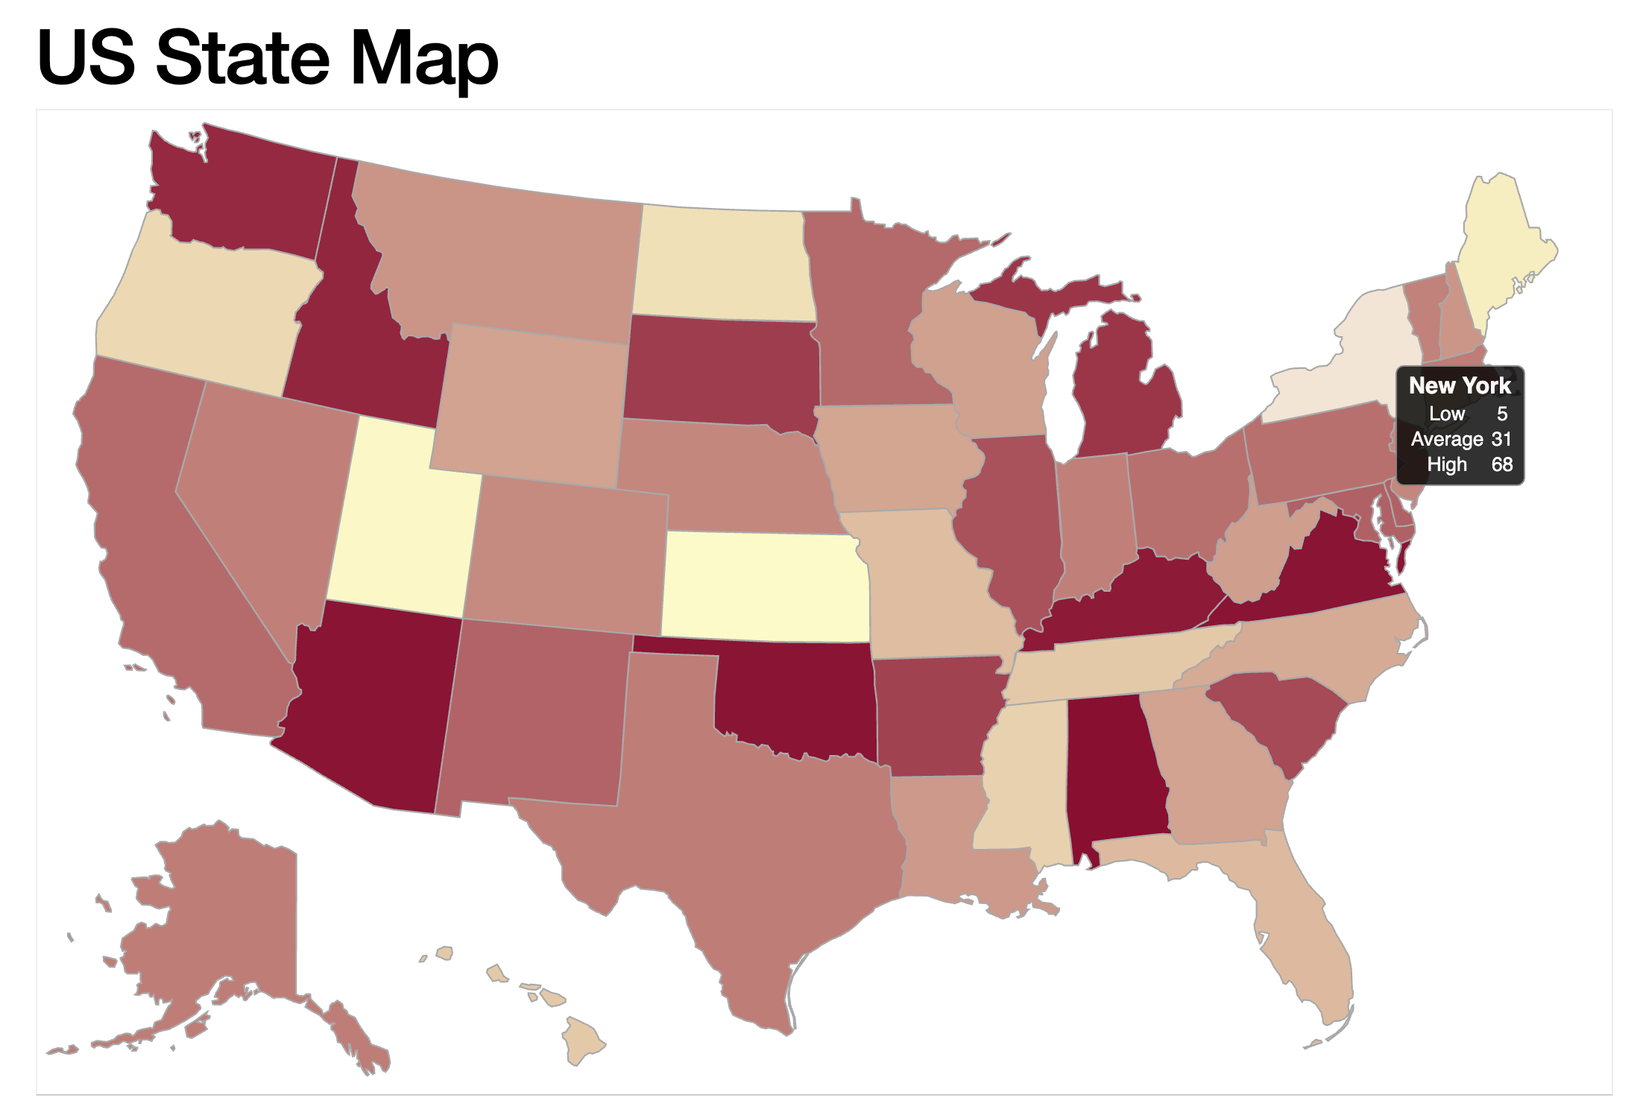
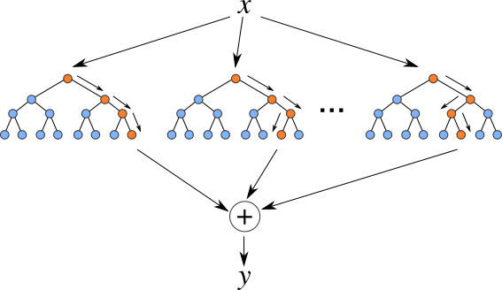
Project analysis slide 10
What’s new in your approach?
We will apply modern machine learning techniques (i.e. regularized regression, regression trees, random forests, etc)
We will create an interactive visualization that users can engage with to better understand the impact of SES on academic performance, ultimately having a larger impact on the end user than a research paper
Random forest regression
https://levelup.gitconnected.com/random-forest-regression-209c0f354c84
Interactive choropleth in D3
http://bl.ocks.org/NPashaP/a74faf20b492ad377312

Slide 8



Project analysis slide 10
What difference will it make?
Our project intends to broaden the scope of awareness of factors such as SES that impact academic performance in a United States education system that is increasingly failing relative to other leading countries
Health-minded citizens, parents, teachers, school administrators, researchers and lawmakers will find this project informative and influential in regards to financial decisions and budgeting to achieve high levels of academic performance^{1,8,10}
Effectively informing stakeholders is a crucial step in effective policymaking
Inform
Create Policy
Improve Education Outcomes

Slide 9
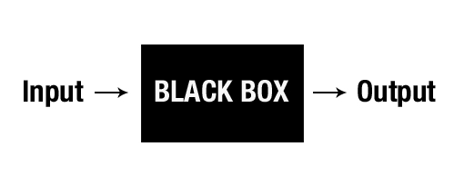
Project analysis slide 10
What are the risks and payoffs?
The ecological fallacy – a misinterpretation of results that apply aggregate findings to individual outcomes when it is not appropriate to do so²
Interpretability of “black box” machine learning models to the intended audience of the project⁹
Confounding variables due to suppressed data

Slide 10
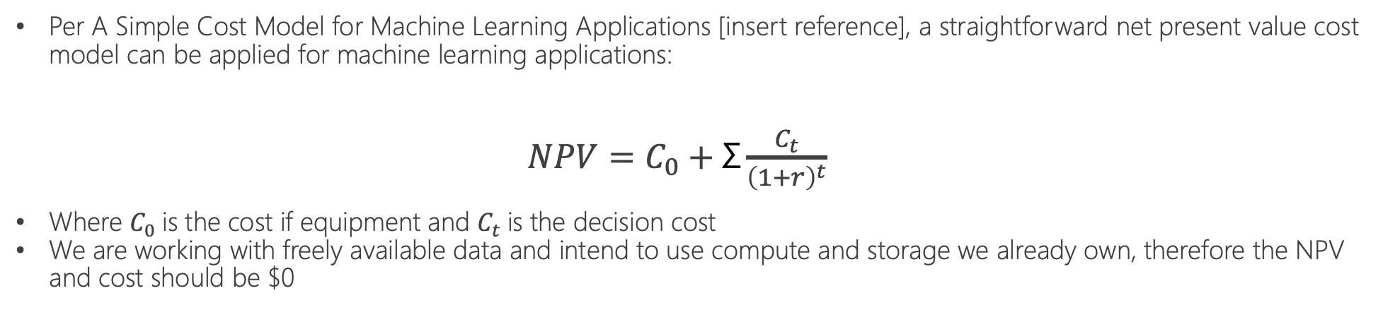
Project analysis slide 10
How much will it cost?
Per A Simple Cost Model for Machine Learning Applications [insert reference], a straightforward net present value cost model can be applied for machine learning applications:
$NPV=C_{0}+\text{Σ}\frac{C_{t}}{{\left(1+r\right)}^{t}}$
Where $C_{0}$is the cost if equipment and $C_{t}$is the decision cost
We are working with freely available data and intend to use compute and storage we already own, therefore the NPV and cost should be $0

Slide 11
Project analysis slide 10
Plan of Activities & Roles
Timeline
Literature survey, proposal and proposal presentation – 1 week
Data loading, cleaning, design, and preliminary modeling – 90±155hrs
Statistics and machine learning modeling – 90±155hrs
D3 visualization, interactivity, testing, iteration – 144±248hrs¹¹
Checks for Success
Cleaned data, preliminary model, functioning choropleth in D3 by end of October
Roles
Documentation, design, organization, presentation, oversight – Nick, Dave, and Shitij
D3 visualization and Python modeling – Vuong, Ben, Shitij, Dave, and Nick (whole team)

Slide 12
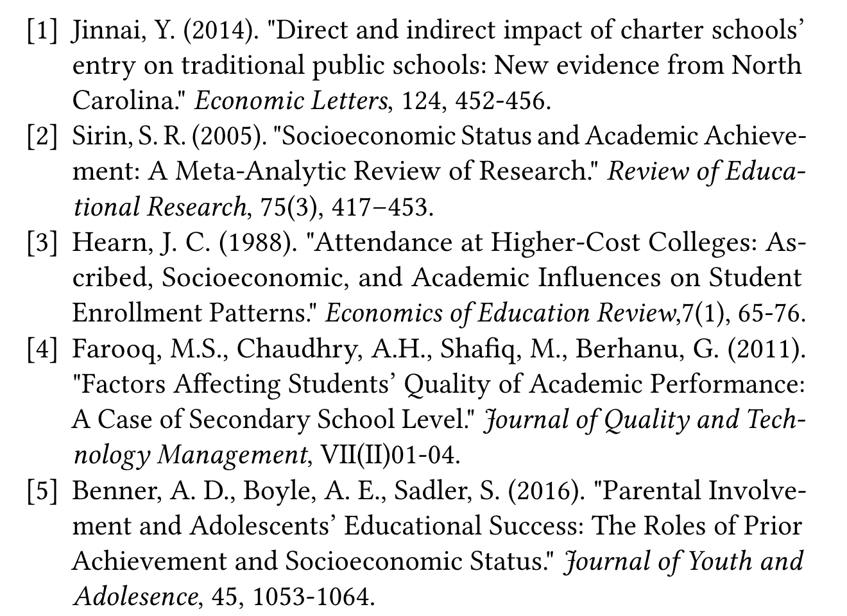

Project analysis slide 10
References

Slide 13
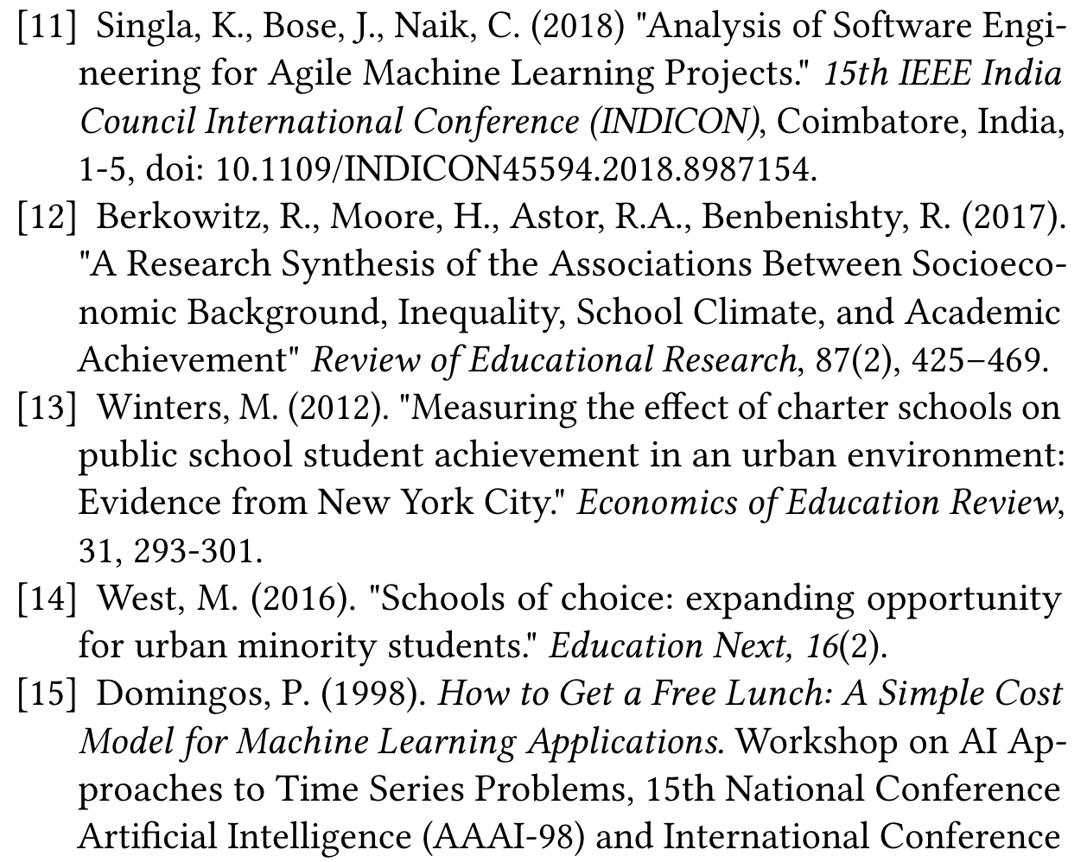

Project analysis slide 10
References

